Slide 1
Intro to Java
An Oversimplification

Slide 2
Procedural programming
Variables, operators, logic, loops, and methods

Slide 3
What is it?
”Normal” programming
Goes in order, step by step
What is used in FLL

Slide 4
Syntax in java
Single-line statements end with a semicolon (;)
Multi-line statements may have programming blocks
Code blocks are denoted with {curly braces}

Slide 5
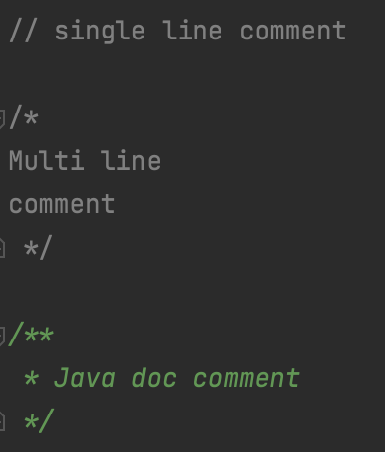
Comments in java
Comments tell others how your program works
Comments are just skipped over when running your program
Will not influence the execution of your program at all
Have single line comments, multi line comments, and Javadoc comments
Single line comments: //
Multi line comments: /* */
Javadoc: /** */
Used for documentation
Comments will be used in this to annotate programs and explain concepts

Slide 6
Packages
Like folders
Goes from broad to narrow
Used to organize programs
To reference a package, put a dot between each part
Normally a backwards domain name (or non-existent domain name)
Package declaration is placed at the top of every file
Example: com.calebli.tutorial

Slide 7
Variables and operations

Slide 8
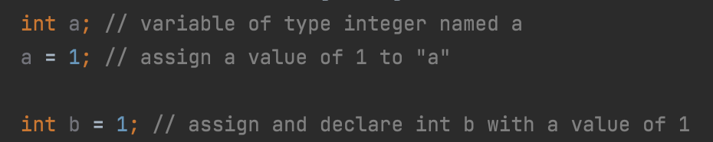
Variables
Stores data of different types
Data can be recalled by using the variable name
Declare a variable with the type and the name
Save a space for a variable of type ___ and give it the name ___
Give variables values with the assignment operator (=)
Able to declare and assign in one step

Slide 9
Primitive Data types
boolean – most basic data type, stores true or false
int (integer) – stores a whole number from -2.15 billion to 2.15 billion
float – stores a floating point number (i.e. decimal point “floats” around); IEEE 32 bit float
double – stores a floating point number double the capacity/precision of a float; IEEE 64 bit float
byte – stores a whole number from -128 to 128
short – store a whole number from -32,768 to 32,767
long – stores a whole number from -2⁶³ to -2⁶³-1
char – stores a Unicode character surrounded by ‘single quotes'
Unicode is a standard for making emojis, symbols, and characters from many different languages

Slide 10
Assigning values
Floats need to be suffixed with an “F” or “f”
Otherwise, Java will think it’s a double
Longs need to be suffixed with an “L” or “l”
Otherwise, Java will think it’s an int
Should not use “l”, might think it is a 1 (one)
Bytes and shorts don’t need to be suffixed with anything
YOU MUST DECLARE VARIABLES BEFORE ASSIGNING THEM

Slide 11
Typecasting

Slide 12
Variables and data types game
Assignment, declaration, and primitive data types

Slide 13
Strings
Store text data
Not a primitive data type, but can be used as one
Created by surrounding text in “double quotes”
Can be combined by “adding” two strings together
“hello “ + “world” = “hello world”

Slide 14
Numeric Operators
Operation | Symbol | Example
Addition | + | 5 + 6 = 11
Subtraction | - | 10 - 8 = 2
Multiplication | * | 9 * 3 = 27
Division | / | 4 / 2 = 2
Modulus | % | 7 % 2 = 1
Addition (+)
Subtraction (-)
Multiplication (*)
Division (/)
Modulus (%)
Remainder
Java follows order of operations
Parentheses, multiplication, division, modulus, addition, subtraction

Slide 15
Integer vs floating point division
If both operands are integers, the decimals are truncated
Example: 5/3 = 1
Both numbers are integers so the decimal part goes away
If at least ONE of the operands is a floating point (float or double), the decimals are NOT truncatetd
Example 5.0/3 = 1.66666667
One number has a decimal so the decimal part stays

Slide 16

Augmented assignment operators
Just like numeric operators but takes value from variable, does operation, and stores result back in variable
Multiply x by 2 to get 6
Store 6 into x

Slide 17
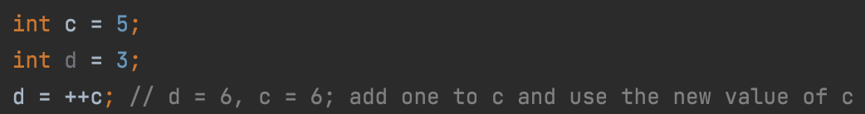
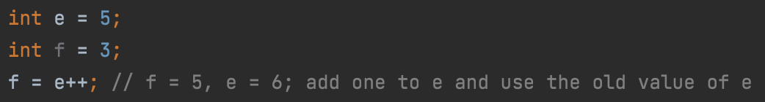
Increment and decrement operators
Add or subtract 1 from the variable
++x, x++, --x, x--
Can be used in expressions or standalone
Pre-increment increments and uses the new value
Post-increment uses the old value then increments
Pre/post doesn’t matter if not using in an expression

Slide 18
Increment and decrement operators cont’d
Name | Symbol | Definition | Example (x = 1)
Pre-increment | ++x | Adds 1 to x and uses the new value | y = ++x y is now 2
Post-increment | x++ | Adds 1 to x and uses the old value | y = x++ y is now 1
Pre-decrement | --x | Subtracts 1 from x and uses the new value | y = --x y is now 0
Post-decrement | x-- | Subtracts 1 from x and uses the old value | y = x-- y is now 1

Slide 19
Boolean operations
AND operator – outputs true if both inputs are true
OR operator – outputs true if either input is true
NOT operator – outputs the opposite of the input
Order of operations
NOT
AND
OR

Slide 20
Truth tables
AND Truth Table
OR Truth Table
A | B | A && B
true | true | true
true | false | false
false | true | false
false | false | false
A | B | A || B
true | true | true
true | false | true
false | true | true
false | false | false
Not Truth Table
A | !A
true | false
false | true

Slide 21
Comparison operators
Operator | Definition | Example
== | Equals | 1 == 1 is true
!= | Not equal | 3 != 2 is true
>= | Greater than or equal to | 2 >= 5 is false
<= | Less than or equal to | 5 <= 5 is true
> | Greater than | 8 > 9 is false
< | Less than | 7 < 5 is false

Slide 22
Java operators game
Numeric, Boolean, and comparison operators

Slide 23
Decision making and logic
If, else, else-if, and switch

Slide 24
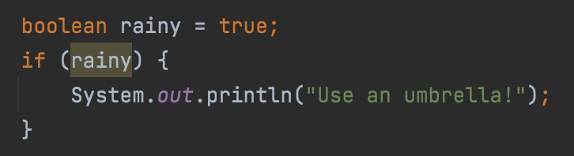
If statement
Body of if statement; code block
Condition to test
If ___ is true, then execute things inside the code block
Otherwise, skip the statement
The condition being tested is in (parentheses)
Things to execute are in the code block

Slide 25
Outputting to the console
System.out.println(”some string”) outputs things to the console (display)
Output of your program
Will be used in this tutorial for program output

Slide 26
Else statement
Instead of skipping the code block when an if statement isn’t true, run the else code block
If ___, run the if code block, otherwise, run the else code block
There is no condition to test for an else statement

Slide 27
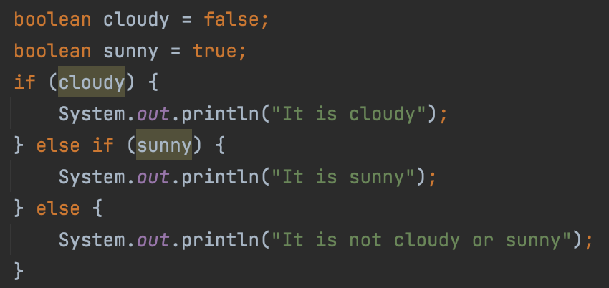
Else if
An else if statement is made up of chained else and if statements
Can be used to do different things depending on the condition
If ___, do A, otherwise if ___, do B, etc.
Only one “branch” of an else if statement is run
Can be chained together infinitely (although this is not recommended)

Slide 28
Formatting
Curly braces are not required for single-line statements in an if/else

Slide 29
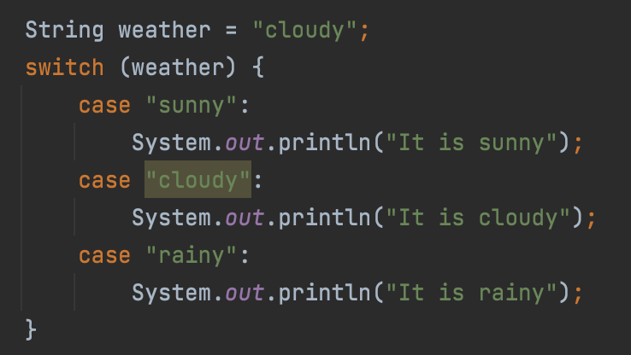
Switch Statement
Checks one value against target values of branches and runs that branch if the two values are the same
Goes down the switch statement checking if ___ is equal to the branch target
In the case of ___, run that branch’s statements
Value to check is the weather variable
Case targets are “sunny”, “cloudy”, and “rainy”
Outputs
”It is cloudy
It is rainy”

Slide 30
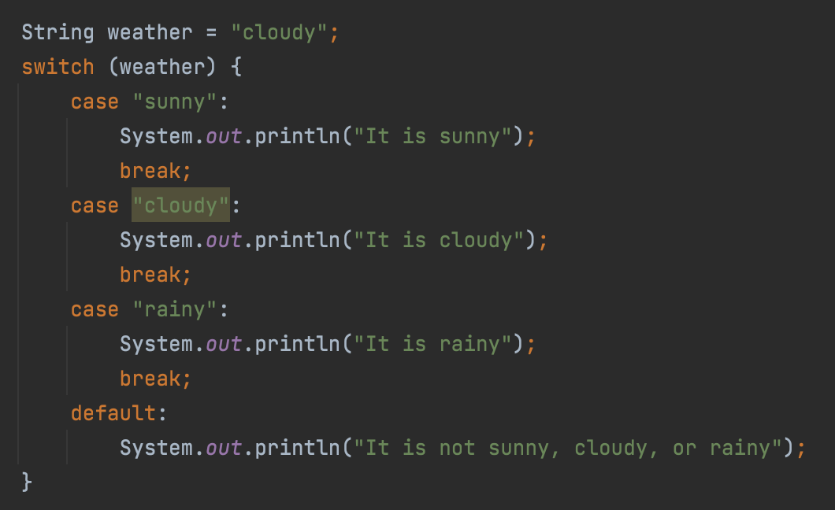
Switch statement cont’d
The cases in the switch statement will ”fall through”
After executing one case, it will execute the case below it
Prevent this behavior with a break statement after the statements in the case
Break statement exits the switch statement and prevents fall through
Default case is run if no matches are found or the switch falls through

Slide 31
Ternary operator
Short form for if-else statements
(condition) ? (if-true) : (if-false)

Slide 32
Loops and iterative constructs
For, while, and do-while

Slide 33
Loops
Run statement(s) multiple times
Prevent writing the same or similar code over and over again
Saves space
Makes code easier to read

Slide 34
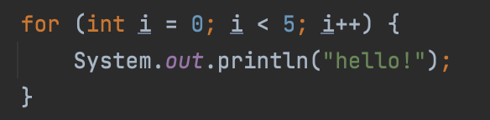
For loops
Initialization statement(s)
Loop continuation condition
End of loop statement(s)
All of these are optional
Runs initialization statements, checks condition, runs statements, runs end of loop statements
Mostly used for counter loops
Loop variable is accessible within the loop

Slide 35
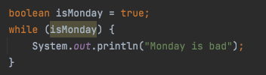
While loops
Checks condition, runs statements, checks condition, etc.
Runs until condition is false
Skipped if condition is initially false
Condition is called a sentinel value

Slide 36
Do-while loops
Same as while loop, but runs statements before checking condition
Means that statements are always run at least once
Good for menu systems; always want the menu to be displayed at least once

Slide 37
When to use each construct
All loops can be created by all three of the constructs
Use for loops for counters
Use while loops if you have a sentinel value
Use do-while loops if you have a while loop that you want to run at least once

Slide 38
Reusing code with methods
Parameters, signatures, headers, and variable scope

Slide 39
methods
Used to reuse code
Switch program control to the method

Slide 40
Why methods?

Slide 41
Parameters and arguments

Slide 42
Return value

Slide 43
Declaration

Slide 44
Method header

Slide 45
Method signature

Slide 46
Method overloading

Slide 47
Scope of variables

Slide 48
Object Oriented Programming (OOP)
Classes, objects, abstraction and encapsulation, relationships, abstract classes, and interfaces

Slide 49
Classes
A blueprint for making something
Fields/attributes
Method to tell how to make the thing (instantiation)
Actions
Has nothing to do with classrooms or school
Example: a class to model a car

Slide 50
objects
Instances of classes
Making an object is instantiating the class
Classes are blueprints, objects are the things created from the blueprints
Example: The car class tells Java how to make a car, the object is the actual car

Slide 51
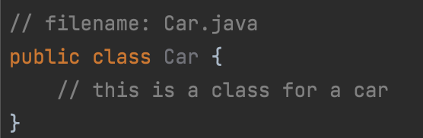
Making a class
Use the class keyword
Name is always UppercaseCamelCase
Usually in its own file with the same name as the class
class ClassName {}

Slide 52
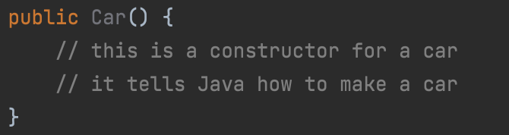
Constructors
Method that tells Java how to make an object from our class (blueprint)
Tells Java how to make a car
Method name is the same as class name
Has no return type, not even void
Should normally be public so others can make an object
Can (and should) be overloaded
Should always have a no-arg constructor (constructor without arguments)

Slide 53
Default constructor
Constructor that is implied if there is no explicitly defined constructor
Has no parameters
Doesn’t do anything
Blank

Slide 54
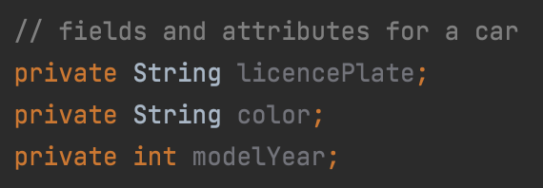
Instance Fields and attributes
Variables that store data about the object
Varies from object to object
Defined in the class
Example: color, size, year

Slide 55
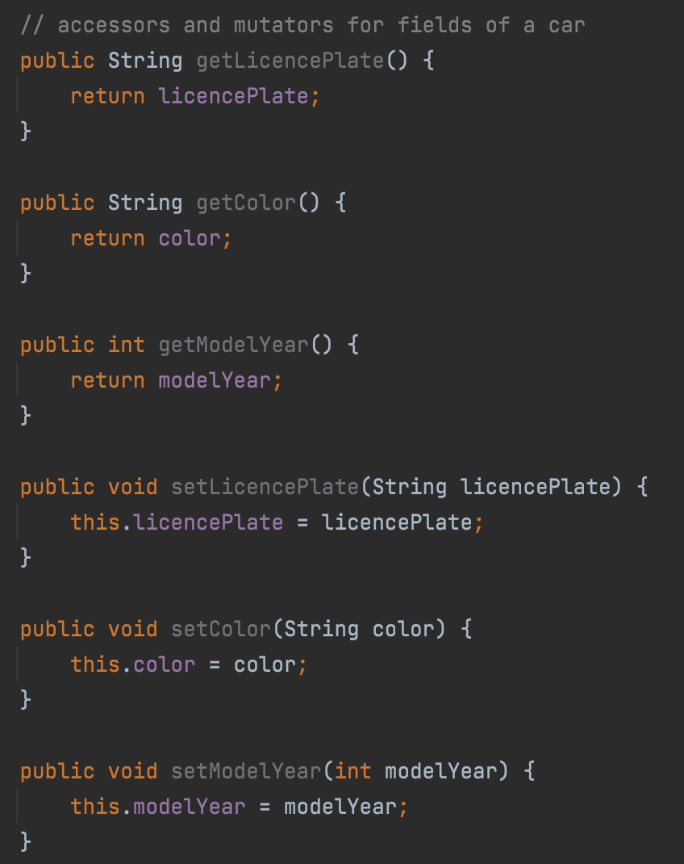
Accessors and mutators
Methods used to read and write data to fields
Can control how fields are manipulated
Fields must be private
Otherwise anyone can access the fields without going through the methods
Also called getters and setters

Slide 56
This
Differentiates between class and local scope
Use this to reference class variable
Local scope always takes precedence
Constructors can call other constructors with this(args-list)
Constructors with less parameters call constructors with more parameters
this = the class

Slide 57
Dot operator
Used to access items inside a package, class, etc.
Example: com.calebli.tutorial.Car.getColor()
Access the getColor method in the car class in the com.calebli.tutorial package

Slide 58
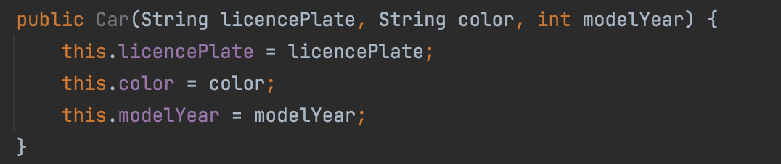
Setting fields when instantiating a class
Set fields in the constructor
Add parameters in the constructor for each field
Assign values to the class fields

Slide 59
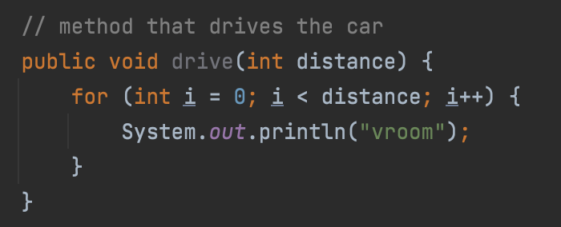
Performing Actions
Methods to perform actions
Normally void because have nothing to return
Example: A drive method in the Car class

Slide 60
Making objects
Done outside of the class (most of the time)
Use the new keyword and the constructor name
Usually assign to a variable
Variable will have data type of the class
Example: A new variable of type car named calebCar

Slide 61

Using classes and objects
Invoking methods with an object
Use the dot operator to get ”inside” the object
Not the class performing the action, but the object
The car is driving, not the blueprint
If I have multiple cars, only the car I select drives
Example: Invokes the drive method on calebCar with a distance of 5

Slide 62
Static methods and fields
Are the same for every object/class, stays “static”
Can still be changed
Do not need to be accessed with an object, can be accessed with a class
Information non-specific to an object
Best practice to access static methods and fields with class instead of objects
Made with the static keyword
Static/instance | Class | Object
Static | Accessible | Accessible
Instance | Not accessible | Accessible

Slide 63
Why OOP?
Ties relevant information together with fields
Makes programs easier to read
Easier to maintain
Easy to reuse code
Structure of code is more clear
Separate different parts of code

Slide 64
Abstraction and encapsulation
Abstraction separates the usage from the implementation
A user doesn’t need to know how the FTC SDK works to use it
Encapsulation hides the implementation, making it a “black box”
To use a class, the user only needs to know its class contract
Public constructors, fields, and methods

Slide 65
Class component recognition
Constructors, fields, getters and setters, and action methods

Slide 66
Case study: Student class
Modeling a student in java with OOP

Slide 67
Relationships between classes

Slide 68
Association

Slide 69
Aggregation

Slide 70
Composition

Slide 71
Inheritence

Slide 72
Abstract classes

Slide 73
interfaces

Slide 74
Unified Modeling Language (UML) Diagrams
Modeling classes and their relationships

Slide 75
Programming the Robot
How to make the wheels spin

Slide 76

Declaring an op mode
Declares name of the class (CalebTest)
Tell Control Hub that this is an op mode
”is a” relationships use extends
Annotation (@TeleOp) says this is a tele op

Slide 77
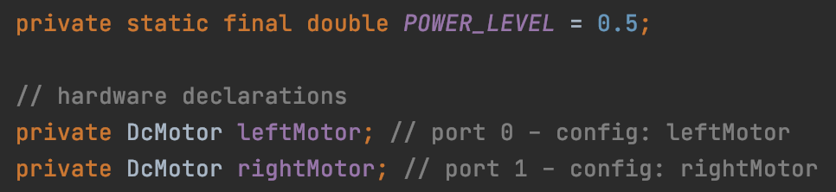
Declaring hardware
Declares and assigns a constant for power level of robot
Says that there is going to be a DcMotor called leftMotor
Says that there is going to be a DcMotor called rightMotor
Comment saying which port the motor is on and its name in the config
Comments denoted with //

Slide 78
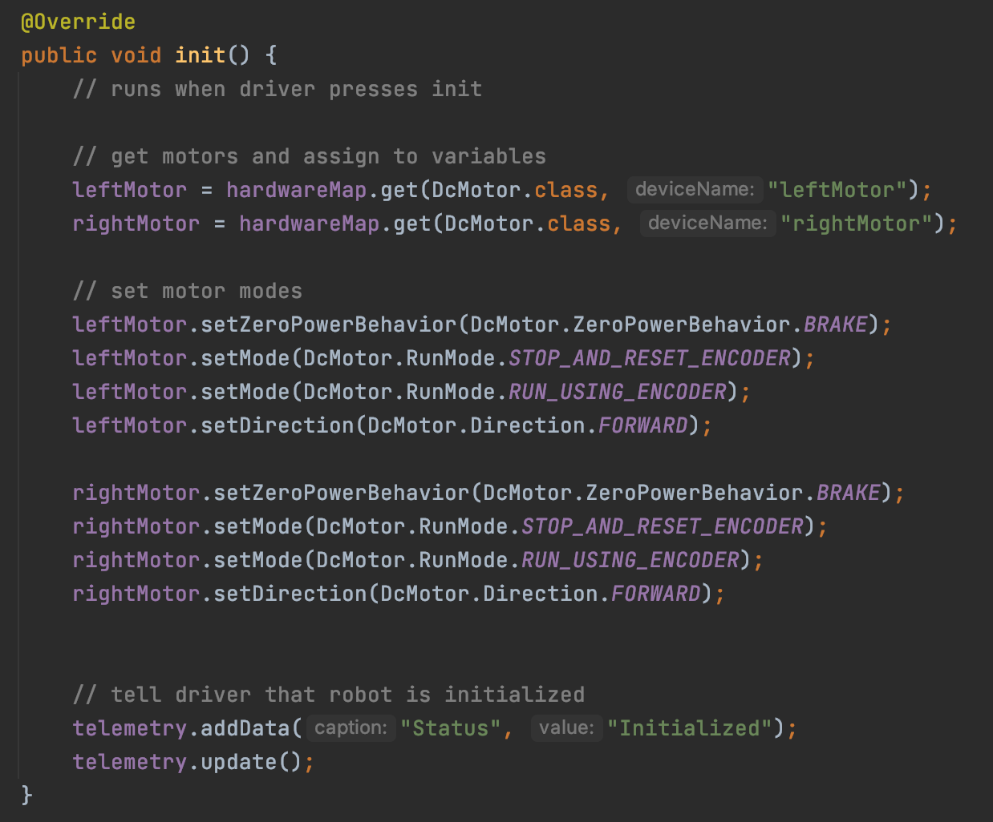
Initialization
Runs when the driver presses init
Assigns hardware to variables
Configures hardware
Calibrates hardware (if applicable)
Send telemetry

Slide 79
Telemetry
Telemetry shows on the driver station phone
It is key value data
Every piece of data (value) needs a header telling what it is (key)
E.g. Heading: 100°
Add telemetry with telemetry.addData(String, String) method
Send telemetry to driver station phone with telemetry.update()

Slide 80
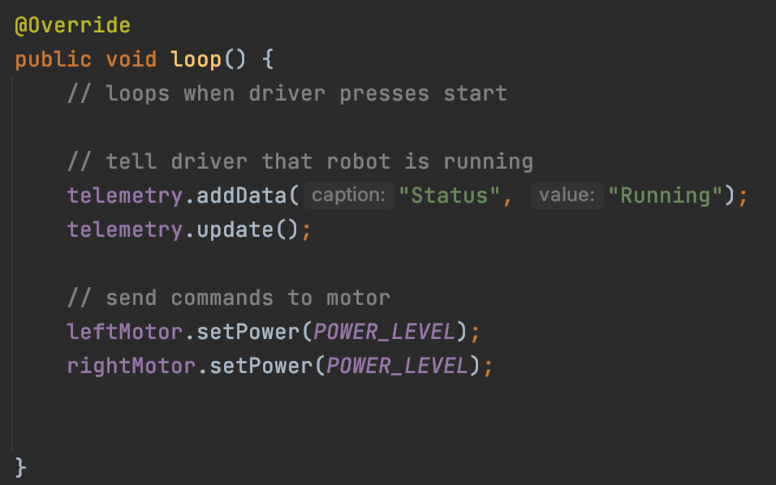
The main loop
Loops when the driver presses play until the driver presses stop
Can send commands, gather sensor data, and make decisions
Procedural

Slide 81
Acceleration curve (Obsolete?)
Changes the amount of time necessary to bring motors up to speed
Why? If we go full speed instantly, we spin out
Slowly bring robot up to speed

Slide 83
Considerations
Think of a maximum time for robot to get to speed
Plot points on a graph
Look at graph and see what would fit the points best

Slide 84
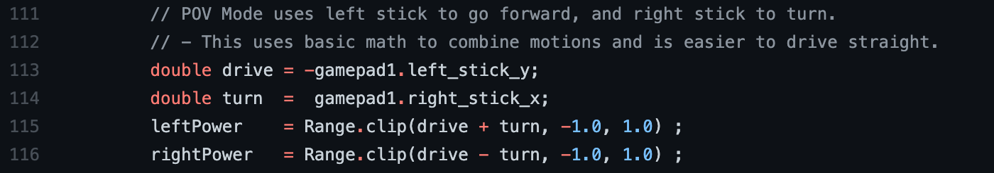
Cut power in half
Divide leftPower and rightPower by 2 (or multiply by 0.5)

Slide 85
Boost mode
If button/trigger pressed, go full speed
Check gamepad with a pre-defined variable
Usually returned from a getter function
Can go full speed by either not dividing in the first place or by multiplying by 2
Question: Which would be more efficient

Slide 86
Traction control
Uses gyroscope to make robot go straight
Calculate desired robot angle (straight, whatever the angle is now)
Find real robot angle
Make corrections
Notes:
For simplicity’s sake, ignore turning

